Slide 1

Team 3: Hafeezah, Connor, Babatola, Selda, Iqra
Chocolate Sales Analysis
Built for business intelligence and decision-making, this tool enables users to uncover sales trends, understand factors affecting chocolate sales and optimize business strategies for increasing revenue.

Slide 2
Overview
Providing an in-depth analysis of dataset and uncovering key insights into which demographics are at risk of having thyroid cancer:
Hypothesis 1: Age and gender influence thyroid cancer risk, with older individuals and females having a higher probability
Validation: Use box plots and regression analysis to explore how cancer risk varies across different age groups and gender distributions
Hypothesis 2: Certain countries and ethnicities have a higher prevalence of thyroid cancer due to genetic and environmental factors
Validation: Conduct geospatial analysis and visualize the distribution of thyroid cancer cases across different regions.

Slide 3
Planning & Design
Ideation
Design
Technologies
Design
Project Goal: Build interactive dashboards for data analysis
Business Requirement: understand factors affecting chocolate sales and optimize business strategies for increasing revenue, improving sales efficiency, and enhancing customer targeting.
Target Audience: Marketing professionals, Sales Managers, Product Managers, Retail Partners, Data Analysts, Executives and Business Owners.
User Stories: "As a
Business Analyst / Sales Manager, view monthly sales trends to identify seasonal demand fluctuations and compare sales performance across different countries
Intuitive UI: Clean layouts, easy navigation
Accessibility: Readable colours, labeling
Interactivity: Clickable filters,
zoomable charts and maps
Hypothesis: Which products are popular in different countries
Tools: Visual Studio Code, Jupyter Notebook, Power BI, Tableau, PowerPoint
Wireframing: Balsamic Wireframes
Project Management: GitHub Projects, Google Meets
Version Control: GitHub for
collaboration
Libraries & Frameworks: Python (Pandas, NumPy, Plotly, Seaborn,Pingoiun), Power BI, Tableau

Slide 4
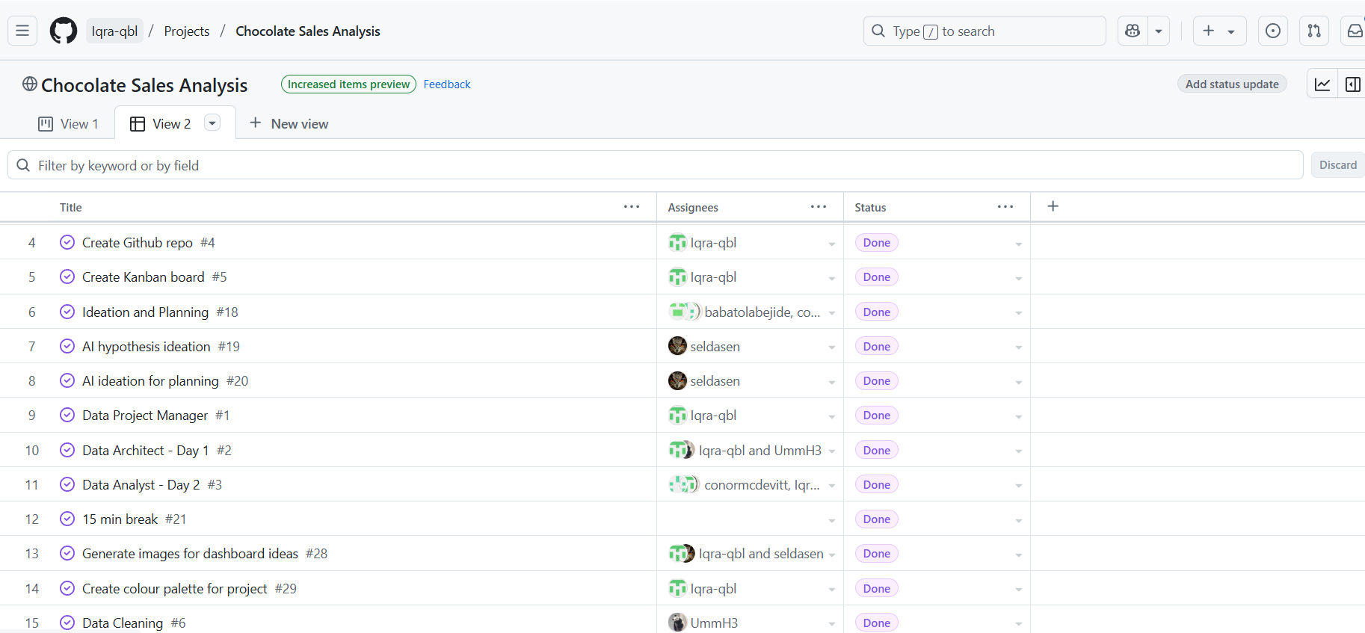
Project Board
Assigned Tasks: 33
MoSCoW Prioritisation:
Must have: interactive dashboards: Tableau & PowerBi and proper documentation
Should have: simple and followable code
Could have: nicely stylized code and dashboard
Would have: sales forecast

Slide 5
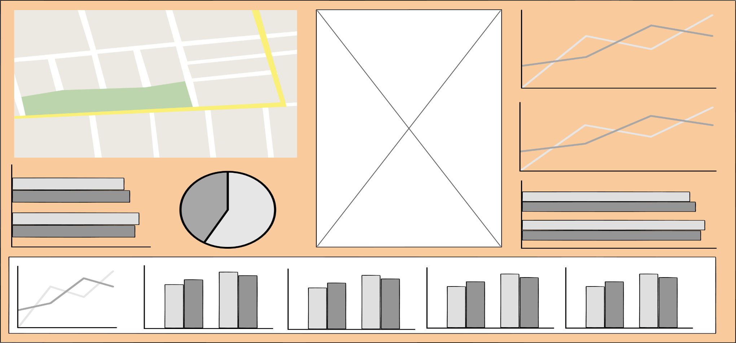
Dashboard Wireframe

Slide 6
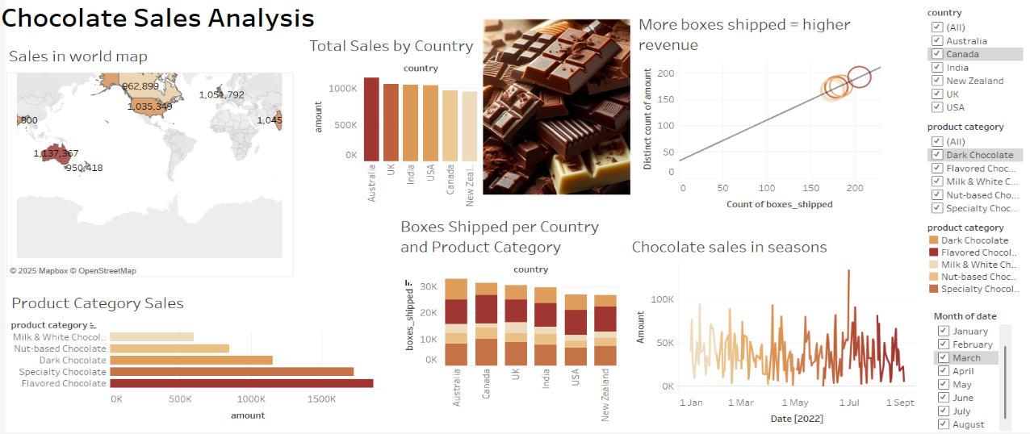
Tableau Features
Interactive: countries are filterable in map, the months and product category are filterable in chocolate sales line chart and bar chart
Hovering over any chart will further explain the data specific e.g. regarding total revenue, product/product category, country etc

Slide 7
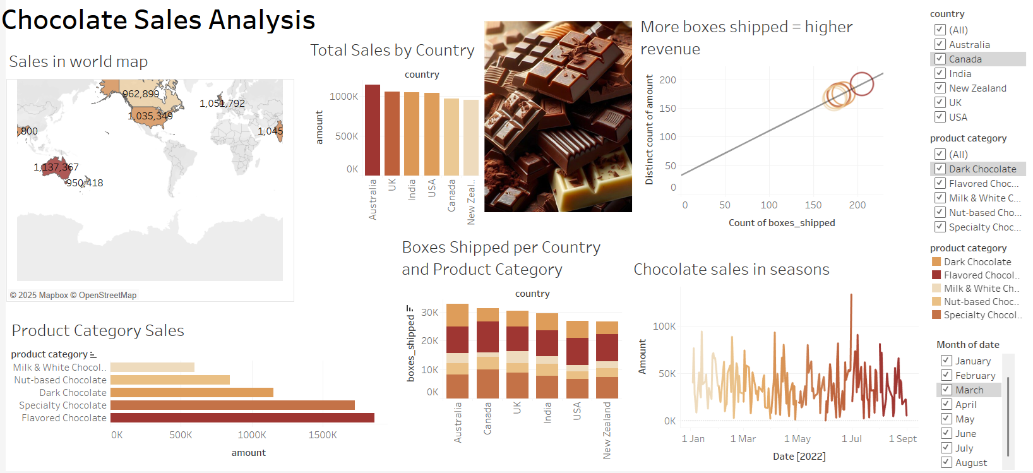
Tableau Features

Slide 8
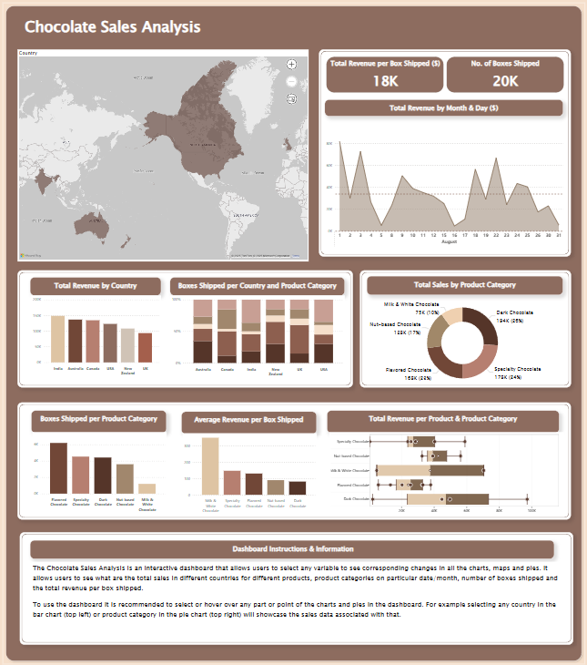
PowerBi Features
Interactive: all variables i.e. total revenue, country, total sales by category, boxes shipped, product category are interlinked so selecting one will show all the relevant data across different charts and map
At the bottom there are instructions on using the different features of the dashboard
Hovering over any chart will further explain the data specific e.g. regarding total revenue, product/product category, country etc

Slide 9
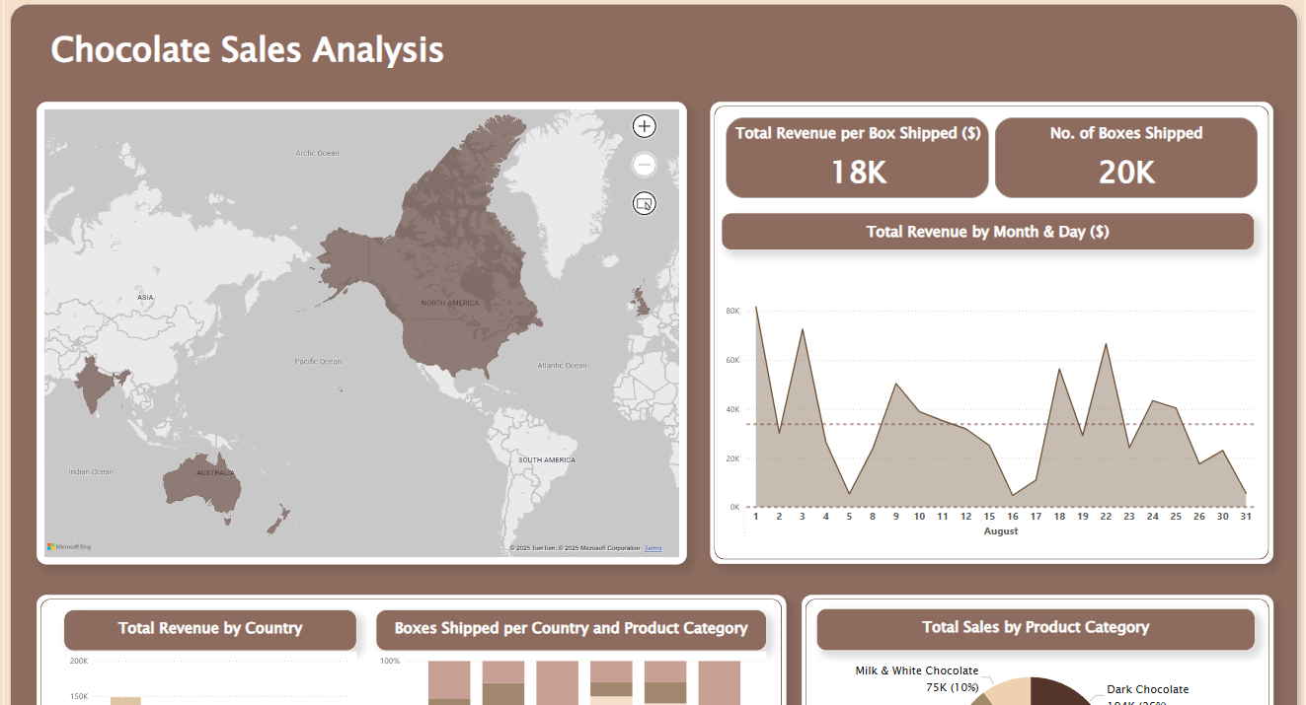
Features

Slide 10
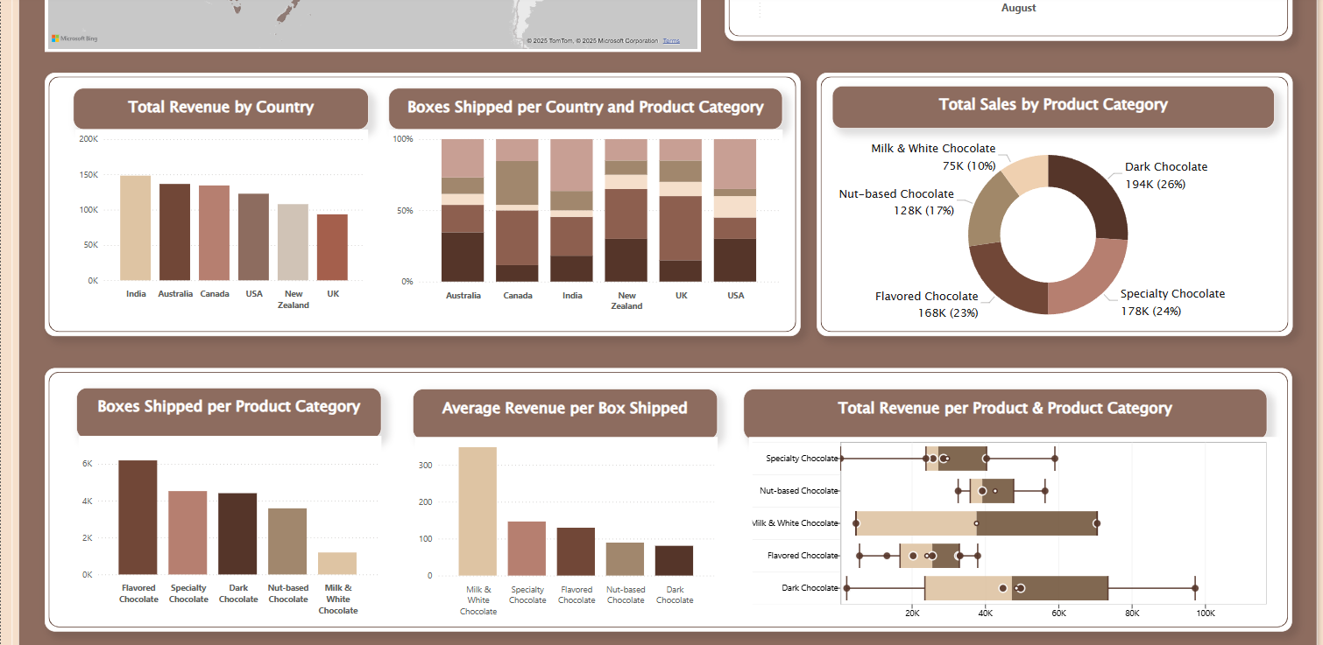
Features

Slide 11
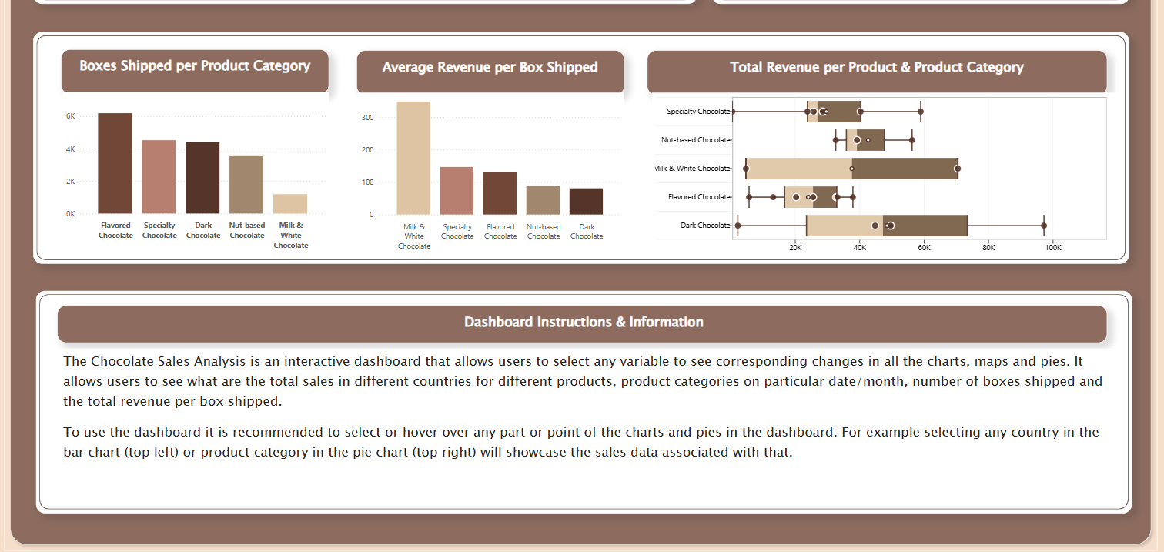

Slide 12
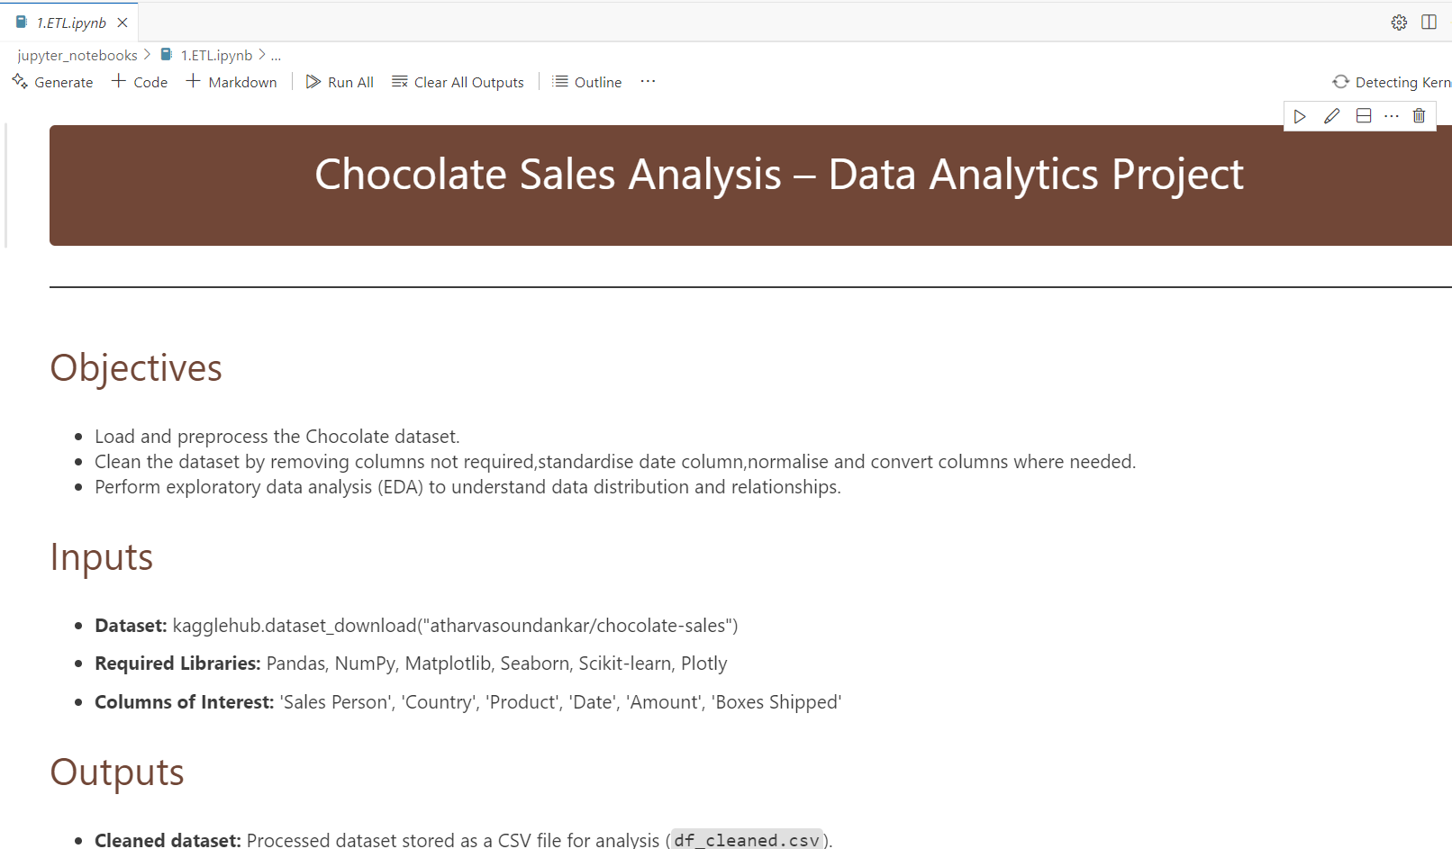

Slide 13
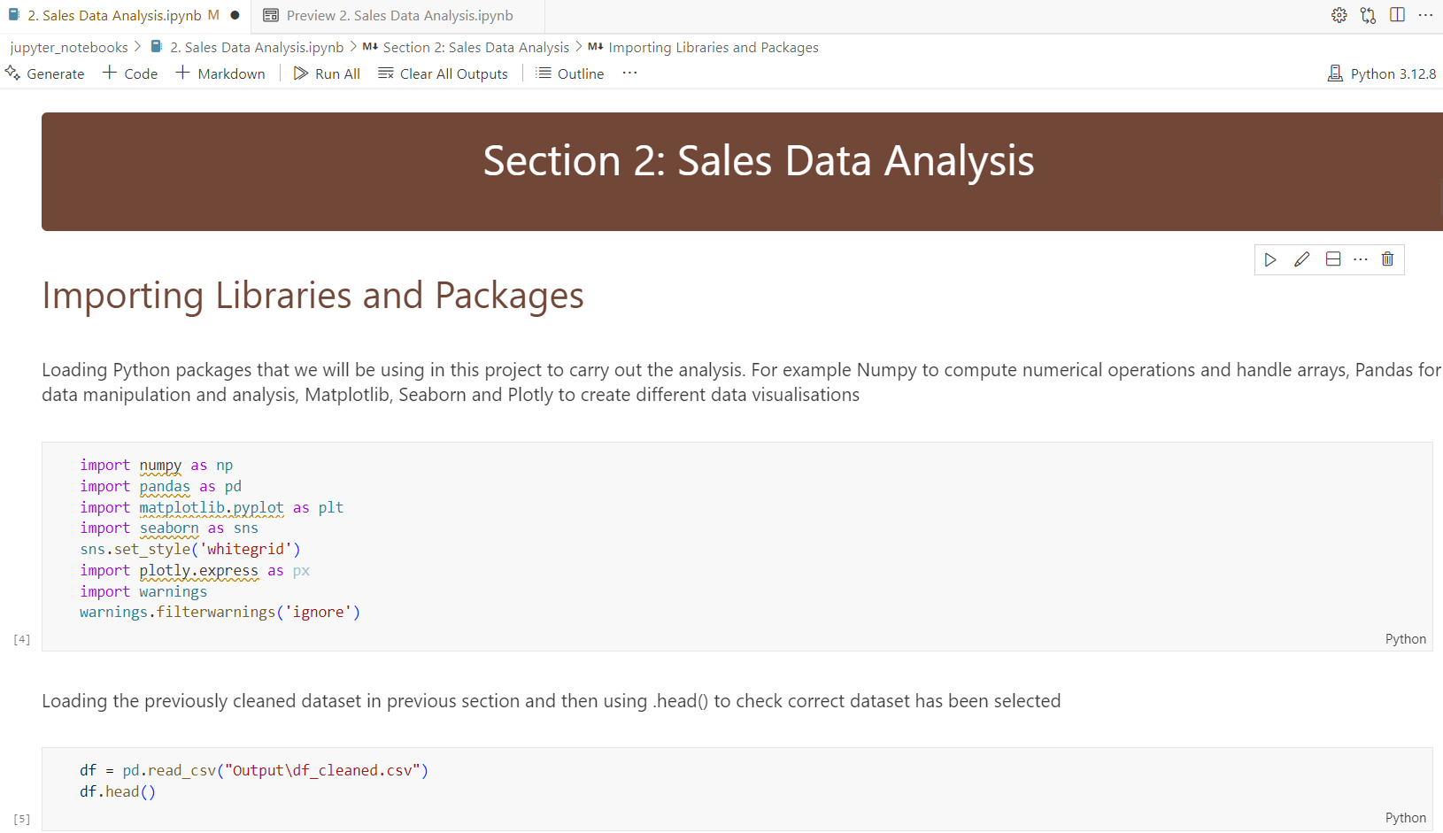

Slide 14
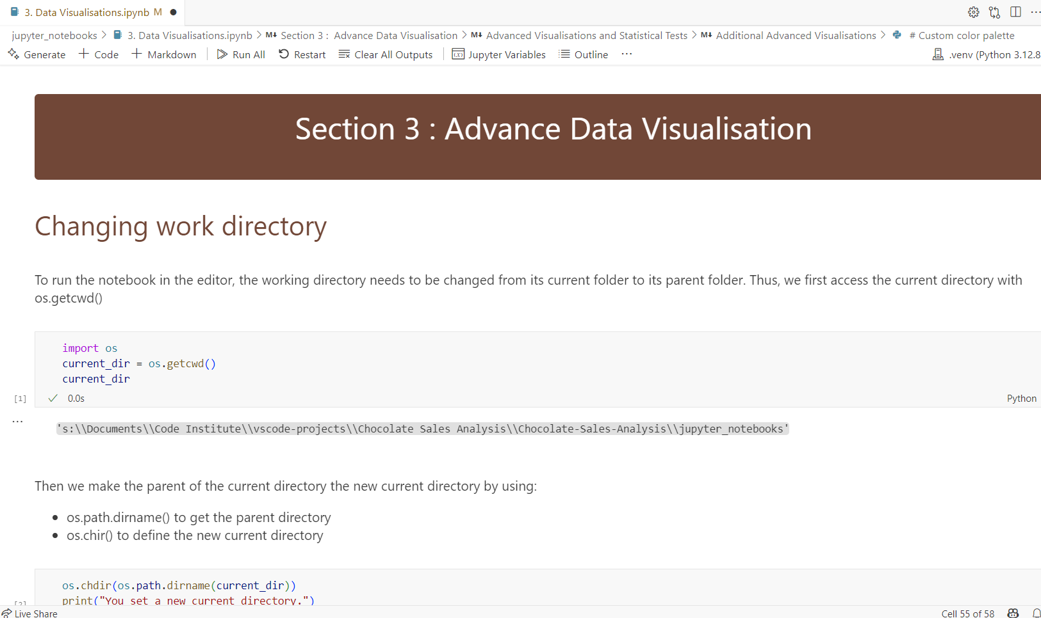

Slide 15
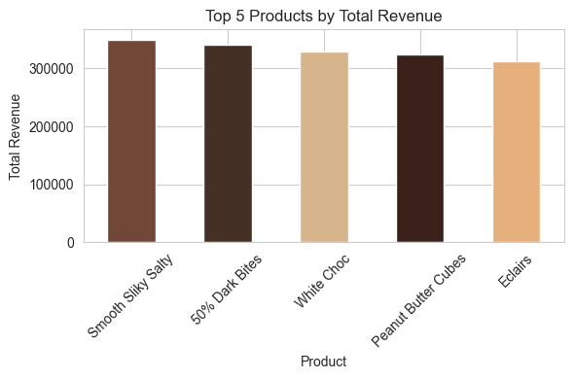
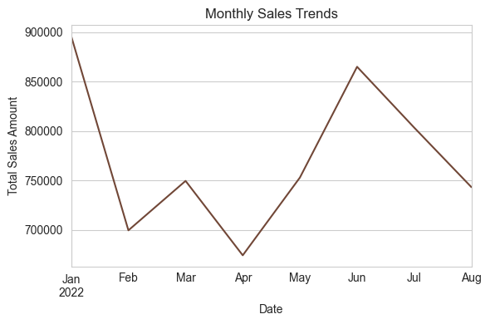
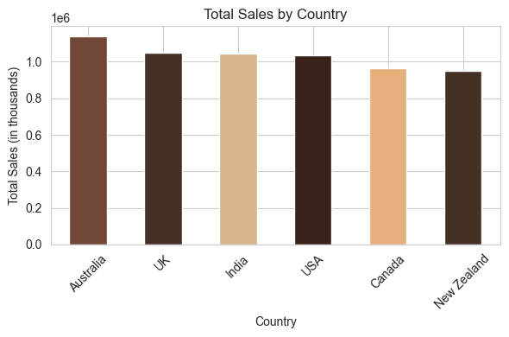

Slide 16
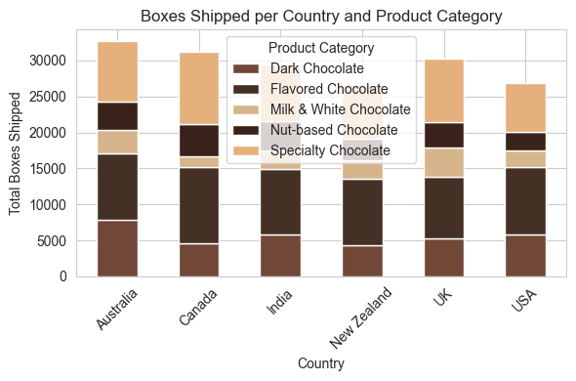
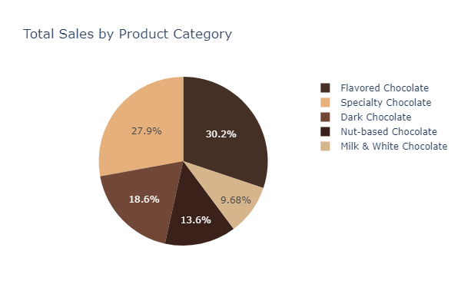

Slide 17
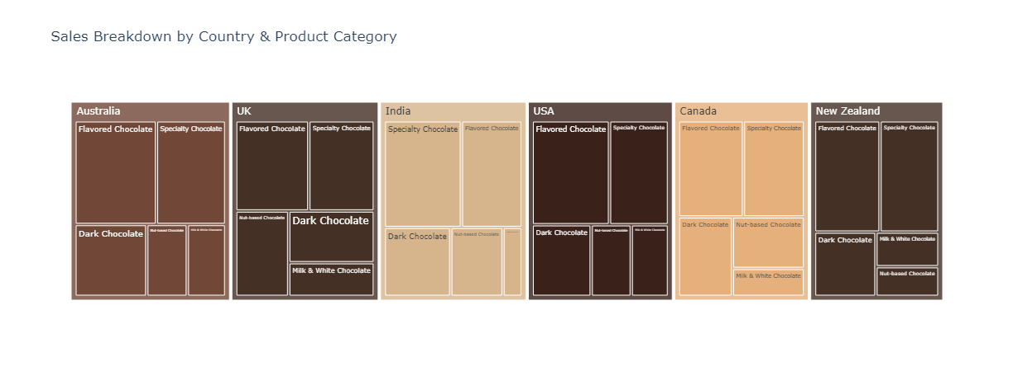

Slide 18
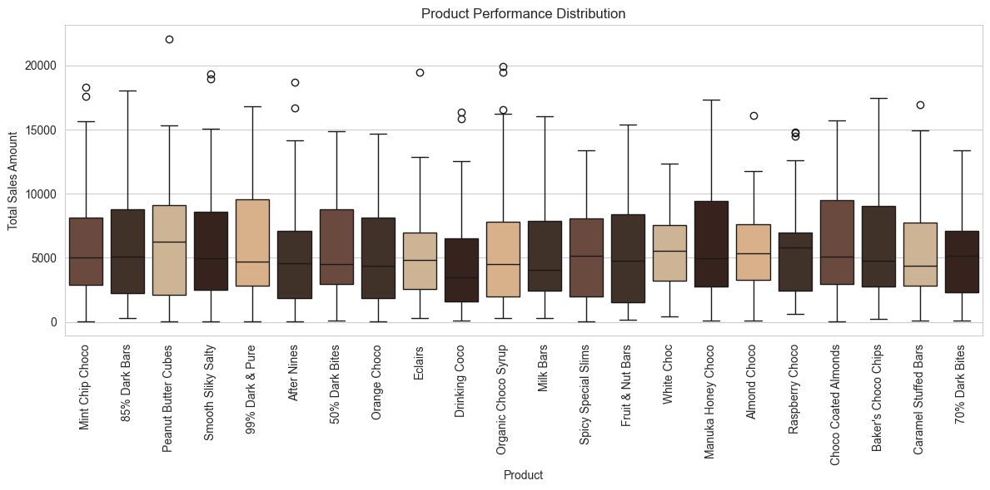

Slide 19
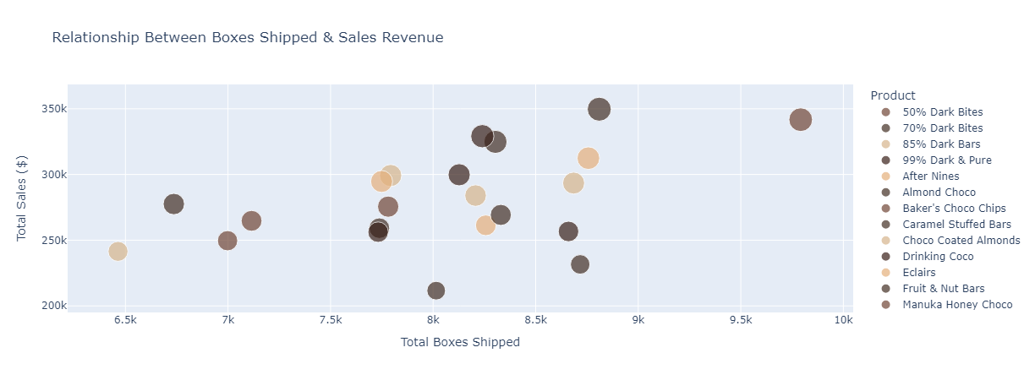

Slide 20
Insights & Finding
3. Top 5 Countries by Total Sales Revenue
Australia ($1,137,367), UK ($1,051,792), India ($1,045,800), USA ($1,035,349) and Canada – ($962,899)
Australia leads in total sales, followed closely by UK and India
India’s high sales suggest strong demand despite potentially different market dynamics
4. Top 5 Best-Selling Chocolate Products
Smooth Silky Salty ($349,692), 50% Dark Bites ($341,712), White Choc ($329,147), Peanut Butter Cubes ($324,842), Eclairs ($312,445)
Dark chocolate & peanut butter varieties perform well, suggesting a preference for premium or unique flavours
Smooth Silky Salty is the best-selling product, potentially due to unique taste or marketing strategies
Summary Statistics (Sales & Shipments)
Average Sales Amount per Transaction: $5,652.31
Standard Deviation of Sales: $4,102.44 (indicating high variability)
Minimum Sale: $7.00 | Maximum Sale: $22,050.00
Median Sales Amount: $4,868.50
Average Boxes Shipped per Transaction: 161.8
2. Correlation Analysis
Sales Amount vs. Boxes Shipped: -0.0188 (Weak Negative Correlation).
This suggests that increasing the number of boxes shipped does not strongly impact total revenue. Some high-revenue sales may involve fewer boxes but premium-priced chocolates

Slide 21
Insights & Finding
5. Monthly Sales Trend (First 7 Months of 2022)
January 2022: $896,105, February 2022: $699,377, March 2022: $749,483, April 2022: $674,051, May 2022: $752,892
January has the highest sales (possibly due to post-holiday chocolate purchases)
Sales drop in February and April, suggesting potential seasonality effects
Sales increase in June again, maybe due to summer holidays

Slide 22
Collaboration & Outcomes
Outcomes
Development Problems
Summary
Are you happy with the final product? Yes
What do you hope to achieve in the
next development cycle?
Create sales forecast for next months
What would you do differently if you could start again?
Problems that arose during development?:
Git collaboration
In group conflicts and resolutions? No
Did you find any of the behaviour related content useful? Teamwork, problem solving etc?
Yes, mindful collaboration and problem- solving, work division
Interactivity: Overall good
Overall group dynamic: Good, friendly, professional
Overall satisfaction: 9/10 (-1 sales forecast)
What we learned: Working with new team members
Our experiences: We had good troubleshooting and mindset for the project
Maybe select dataset with more months or years recorded data

Slide 23


